Slide 1
Azure Developer Camp

Slide 2
Kubernetes

Slide 3
Introduction
?
What is and What is not?
Kubernetes Components
AKS
+
ACI
Introduction
Kubernetes Objects
Azure Kubernetes Service
Kubernetes API
Notes:
Google necessarily had to create a lot of orchestration and scheduling
software to handle isolation, load balancing, and placement.
That system is called Borg, and it schedules and launches approximately
7,000 containers a second on any given day.
With the initial release of Docker in March of 2013, Google decided
it was finally time to take the most useful bits of
the Borg cluster management system, package them up and publish
them via Open Source.
The result was the Kubernetes open-source project

Slide 4
Features of Kubernetes
Notes:
Kubernetes automatically packages your application and schedules the containers based on their requirements and available resources while not sacrificing availability. To ensure complete utilization and save unused resources, Kubernetes balances between critical and best-effort workloads.
With Kubernetes, there is no need to worry about networking and communication because Kubernetes will automatically assign IP addresses to containers and a single DNS name for a set of containers, that can load-balance traffic inside the cluster.
With Kubernetes, you can mount the storage system of your choice. You can either opt for local storage, or choose a public cloud provider such as GCP or AWS, or perhaps use a shared network storage system such as NFS, iSCSI, etc.
Kubernetes can automatically restart containers that fail during execution and kills those containers that don’t respond to user-defined health checks. But if nodes itself die, then it replaces and reschedules those failed containers on other available nodes.
Kubernetes can help you deploy and update secrets and application configuration without rebuilding your image and without exposing secrets in your stack configuration.
In addition to managing services, Kubernetes can also manage your batch and CI workloads, thus replacing containers that fail, if desired.
Kubernetes needs only 1 command to scale up the containers, or to scale them down when using the CLI. Else, scaling can also be done via the Dashboard.
Kubernetes progressively rolls out changes and updates to your application or its configuration, by ensuring that not all instances are worked at the same instance. Even if something goes wrong, Kubernetes will rollback the change for you.

Slide 5
What is and What is not Kubernetes?
?
What is and What is not?
Kubernetes Components
AKS
+
ACI
Introduction
Kubernetes Objects
Azure Kubernetes Service
Kubernetes API

Slide 6
What is Kubernetes?
Kubernetes (K8s) is an open source project that was released by Google in June, 2014.
Kubernetes is an orchestration framework for Docker containers which helps expose containers as services to the outside world
It is a multi-container management solution.
Notes:
For example, you can have two services − One service would contain nginx and mongoDB, and another service would contain nginx and redis. Each service can have an IP or service point which can be connected by other applications. Kubernetes is then used to manage these services

Slide 7
How Kubernetes works?
Internet
Kubernetes control
Worker node
kubelet
kube-proxy
Kubernetes users communicate with API server and apply desired state
Master node
Docker
Prod
Prod
Master nodes actively enforce desired state on worker nodes
API server
Containers
Containers
Worker nodes support communication between containers
-controller-manager
-scheduler
Worker node
kubelet
kube-proxy
Worker nodes support communication from the Internet
replication, namespace, serviceaccounts, etc.
etcd
Docker
Prod
Prod
Containers
Containers
Notes:
The master runs three main items:
API Server nearly all the components on the master and nodes accomplish their respective tasks by making API calls.
Etcd is a service whose job is to keep and replicate the current configuration and run state of the cluster.
Scheduler and Controller Manager These processes schedule containers onto target nodes.
A node usually runs three important processes:
Kubelet A special background process (daemon that runs on each node whose job is respond to commands from the master to create, destroy and monitor the containers on that host.)
Proxy This is a simple network proxy that’s used to separate the IP address of a target container from the name of the service it provides.
cAdvisor This is optional is a special daemon that collects, aggregates, processes and exports information about running containers.

Slide 8
What is not Kubernetes?
Kubernetes is not a containerization platform
Does not limit the types of applications supported
Does not deploy source code and does not build your application
Does not provide application-level services
Does not dictate logging, monitoring, or alerting solutions
Does not provide nor mandate a configuration language/system (e.g Jsonnet)
Does not provide nor adopt any comprehensive machine configuration, maintenance, management, or self-healing systems
Notes:
(intro)
Kubernetes provides the building blocks for building developer platforms but preserves user choice and flexibility where it is important.
(description every point)
Does not limit the types of applications supported. Kubernetes aims to support an extremely diverse variety of workloads, including stateless, stateful, and data-processing workloads. If an application can run in a container, it should run great on Kubernetes.
Does not deploy source code and does not build your application. Continuous Integration, Delivery, and Deployment (CI/CD) workflows are determined by organization cultures and preferences as well as technical requirements.
Does not provide application-level services, such as middleware (e.g., message buses), data-processing frameworks (for example, Spark), databases (e.g., mysql), caches, nor cluster storage systems (e.g., Ceph) as built-in services. Such components can run on Kubernetes, and/or can be accessed by applications running on Kubernetes through portable mechanisms, such as the Open Service Broker.
Does not dictate logging, monitoring, or alerting solutions. It provides some integrations as proof of concept, and mechanisms to collect and export metrics.
Does not provide nor mandate a configuration language/system (e.g., jsonnet). It provides a declarative API that may be targeted by arbitrary forms of declarative specifications.
Does not provide nor adopt any comprehensive machine configuration, maintenance, management, or self-healing systems.

Slide 9
Kubernetes Components
?
What is and What is not?
Kubernetes Components
AKS
+
ACI
Introduction
Kubernetes Objects
Azure Kubernetes Service
Kubernetes API

Slide 10
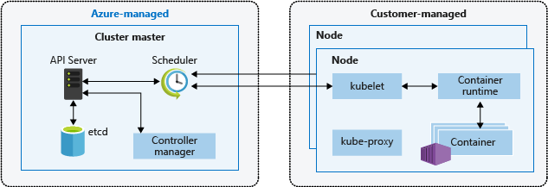
Kubernetes cluster architecture
Notes:
A Kubernetes cluster is divided into two components:
Cluster master nodes provide the core Kubernetes services and orchestration of application workloads.
Nodes run your application workloads.

Slide 11
Master Components
kube-apiserver
Etcd
Kube-scheduler
Kube-controller-manager
Cloud-controller-manager
Notes:
kube-apiserver:
Component on the master that exposes the Kubernetes API. It is the front-end for the Kubernetes control plane. It is designed to scale horizontally – that is, it scales by deploying more instances.
Etcd:
Consistent and highly-available key value store used as Kubernetes’ backing store for all cluster data.
Kube-scheduler:
Component on the master that watches newly created pods that have no node assigned and selects a node for them to run on.
kube-controller-manager:
Component on the master that runs controllers.
Logically, each controller is a separate process, but to reduce complexity, they are all compiled into a single binary and run in a single process.
Cloud-controller-manager:
cloud-controller-manager runs controllers that interact with the underlying cloud providers.

Slide 12
Node Components
kubelet
Kube-proxy
Container Runtime
Notes:
Kubelet:
An agent that runs on each node in the cluster. It makes sure that containers are running in a pod.
Kube-proxy:
kube-proxy enables the Kubernetes service abstraction by maintaining network rules on the host and performing connection forwarding.
Container Runtime:
The container runtime is the software that is responsible for running containers. Kubernetes supports several runtimes: Docker, containerd, cri-o, rktlet and any implementation of the Kubernetes CRI (Container Runtime Interface).

Slide 13
Kubernetes Objects
?
What is and What is not?
Kubernetes Components
AKS
+
ACI
Introduction
Kubernetes Objects
Azure Kubernetes Service
Kubernetes API

Slide 14
Kubernetes Objects
What containerized applications are running (and on which nodes)
The resources available to those applications
The policies around how those applications behave, such as restart policies, upgrades, and fault-tolerance
Notes:
(intro)
Kubernetes uses these entities to represent the state of your cluster. Specifically, they can describe:
A Kubernetes object is a “record of intent”–once you create the object, the Kubernetes system will constantly work to ensure that object exists. By creating an object, you’re effectively telling the Kubernetes system what you want your cluster’s workload to look like; this is your cluster’s desired state.

Slide 15
Describing a Kubernetes Object
application/deployment.yaml
apiVersion: apps/v1 # for versions before 1.9.0 use apps/v1beta2
kind: Deployment
metadata:
name: nginx-deployment
spec:
selector:
matchLabels:
app: nginx
replicas: 2 # tells deployment to run 2 pods matching the template
template:
metadata:
labels:
app: nginx
spec:
containers:
- name: nginx
image: nginx:1.7.9
ports:
- containerPort: 80
Notes:
When you create an object in Kubernetes, you must provide the object spec that describes its desired state, as well as some basic information about the object (such as a name). When you use the Kubernetes API to create the object (either directly or via kubectl), that API request must include that information as JSON in the request body. Most often, you provide the information to kubectl in a .yaml file. kubectl converts the information to JSON when making the API request.

Slide 16
Required Fields
apiVersion - Which version of the Kubernetes API you’re using to create this object
kind - What kind of object you want to create
metadata - Data that helps uniquely identify the object, including a name string, UID, and optional namespace
Notes:
In the .yaml file for the Kubernetes object you want to create, you’ll need to set values for the following fields

Slide 17
Kubernetes API
?
What is and What is not?
Kubernetes Components
AKS
+
ACI
Introduction
Kubernetes Objects
Azure Kubernetes Service
Kubernetes API

Slide 18
Kinds
Objects represent a persistent entity in the system
Lists are collections of resources of one (usually) or more (occasionally) kinds
Simple kinds are used for specific actions on objects and for non-persistent entities

Slide 19
Objects
Creating an API object is a record of intent - once created, the system will work to ensure that resource exists. All API objects have common metadata.
An object may have multiple resources that clients can use to perform specific actions that create, update, delete, or get.
Notes:
Examples: Pod, ReplicationController, Service, Namespace, Node.

Slide 20
Lists
The name of a list kind must end with "List". Lists have a limited set of common metadata. All lists use the required "items" field to contain the array of objects they return. Any kind that has the "items" field must be a list kind.
Most objects defined in the system should have an endpoint that returns the full set of resources, as well as zero or more endpoints that return subsets of the full list. Some objects may be singletons (the current user, the system defaults) and may not have lists.
Notes:
In addition, all lists that return objects with labels should support label filtering (see the labels documentation), and most lists should support filtering by fields.
Examples: PodLists, ServiceLists, NodeLists.

Slide 21
Simple
Given their limited scope, they have the same set of limited common metadata as lists.
For instance, the "Status" kind is returned when errors occur and is not persisted in the system.
Many simple resources are "subresources", which are rooted at API paths of specific resources. When resources wish to expose alternative actions or views that are closely coupled to a single resource, they should do so using new sub-resources.

Slide 22
Simple
/binding Used to bind a resource representing a user request (e.g., Pod, PersistentVolumeClaim) to a cluster infrastructure resource (e.g., Node, PersistentVolume)
/status Used to write just the status portion of a resource. For example, the /pods endpoint only allows updates to metadata and spec, since those reflect end-user intent
/scale Used to read and write the count of a resource in a manner that is independent of the specific resource schema.
Notes:
(intro)
Common subresources include:
Two additional subresources, proxy and portforward, provide access to cluster resources as described in accessing the cluster.

Slide 23
Azure Kubernetes Service
?
What is and What is not?
Kubernetes Components
AKS
+
ACI
Introduction
Kubernetes Objects
Azure Kubernetes Service
Kubernetes API

Slide 24
AKS: Simplify the deployment, management, and operations of Kubernetes
Deploy and manage Kubernetes with ease
Accelerate containerized application development
Set up CI/CD in a few clicks
Secure your Kubernetes environment
Scale and run applications with confidence
Work how you want with open-source tools and APIs

Slide 25
Azure makes Kubernetes easy
Deploy and manage Kubernetes with ease
Task | The old way | With Azure
Create a cluster | Provision network and VMs Install dozens of system components including etcd Create and install certificates Register agent nodes with control plane | AZ AKS create
Upgrade a cluster | Upgrade your master nodes Cordon/drain and upgrade worker nodes individually | AZ AKS upgrade
Scale a cluster | Provision new VMs Install system components Register nodes with API server | AZ AKS scale

Slide 26



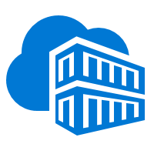


End-to-end experience
Helm chart
AKS production cluster
Front end
Inner loop
Azure Container Registry
Source code control
Azure Monitor
Azure DevSpaces
AKS dev cluster
Test
Business logic
Debug
Auto-build
Azure Pipelines/ DevOps Project
Database tier
CI/CD

Slide 27
Secure your Kubernetes environment
Control access through AAD and RBAC
Safeguard keys and secrets with Key Vault
Secure network communications with VNET and CNI
Compliant Kubernetes service with certifications covering SOC, HIPAA, and PCI

Slide 28


Scale and run with confidence
Built-in auto scaling
Global data center
Elastically burst using ACI
Geo-replicated container registry
Geo-replicated container registry
Azure Container Instances
Pod
Pod
Pod
Pod
Traffic manager
AKS clusters
Browser
Pod
Pod

Slide 29
Azure Kubernetes Service
?
What is and What is not?
Kubernetes Components
AKS
+
ACI
Introduction
Kubernetes Objects
Azure Kubernetes Service
Kubernetes API

Slide 30
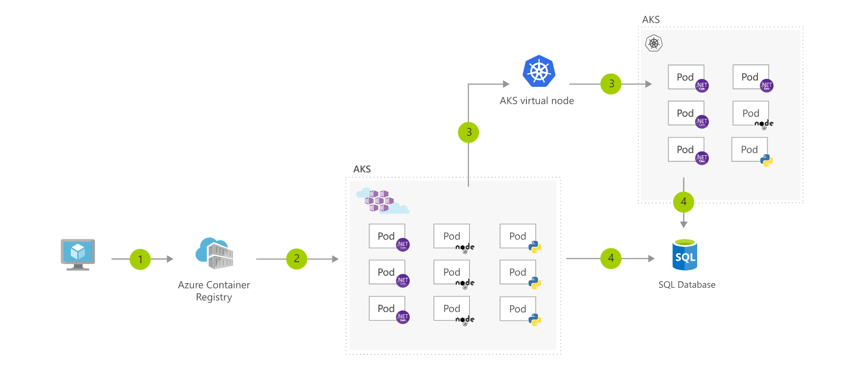
AKS and ACI
Notes:
Use the AKS virtual node to provision pods inside ACI that start in seconds. This enables AKS to run with just enough capacity for your average workload. As you run out of capacity in your AKS cluster, scale out additional pods in ACI without any additional servers to manage.
User registers container in Azure Container Registry
Container images are pulled from the Azure Container Registry
AKS virtual node, a Virtual Kubelet implementation, provisions pods inside ACI from AKS when traffic comes in spikes.
AKS and ACI containers write to shared data store

Slide 31



Real Life Examples
Elastacloud
Hafslund Nett
WhiteSource
Notes:
Elastacloud, a London-based data science consultancy, wanted to combine AI, advanced analytics, and machine learning to promote more profitable low-carbon energy production in the United Kingdom. So, it used Microsoft Azure Machine Learning to build and run the Elastacloud Energy BSUoS (Balancing Services Use of System) Forecast service, an AI-powered web service that helps energy providers avoid incurring energy-balancing fees imposed by national energy authorities. Now providers can better predict energy prices and help create a smarter energy system, while Elastacloud transforms its business.
Hafslund Nett (Hafslund)—the power grid operator that serves 1.5 million Norwegians—determined that legacy systems for reading meter data needed higher capacity and that externally developed software was difficult to manage. To address the issue, Hafslund chose to develop its own meter-system software, using Microsoft Azure as its cloud platform, Azure Kubernetes Service (AKS) to manage software containers, and Azure Monitor for containers to optimize container performance. Hafslund IT staff will soon save time managing their improved systems, and customers will benefit from higher reliability.
WhiteSource simplifies open-source usage management for security and compliance professionals worldwide. Now the WhiteSource solution can meet the needs of even more companies, thanks to a re-engineering effort that incorporated Azure Kubernetes Service (AKS).

Slide 32


Continue with your own journey
Simplify Kubernetes management, deployment, and operations (AKS)
Learn more about Kubernetes on Windows
facebook.com/MSFTDev.US
@MSDEV

Slide 33
Thank You

